Slide 1
Healing Touch

Slide 2
Team
Michael Fore – Testing Lead
Jeffrey Newton – Documentation Lead
Sean Owen – Project Manager
Anh Pham – iPad Lead
Jeff Regan – Healing Vision/Database Lead
Alex Welsh – Surface Lead
Matthew Williams – Website Lead

Slide 3
Agenda
Overview
Plan
Requirements
Design
Platform Demos
Next Semester Plans
Q/A

Slide 4
Healing Touch
The primary objective of Healing Touch is to create a computerized system designed to provide therapeutic and rehabilitative exercises through gaming on multi-user, multi-touch devices.

Slide 5
Why Healing Touch?
Large enough for a group of 7
Provides an opportunity to work with an outside customer
Enables the use of new technology in the form of the iPad and Surface

Slide 6
Project plan agenda
Schedule
Software/Hardware Resources
Monitoring/Reporting
Website

Slide 7
Schedule
Iteration Zero:
Initial network setup
Completed database connectivity among platforms
Iteration One:
Complete initial application & database framework
Iterations Two - Four:
Completion of Healing Vision
System testing of developed games
Code completion

Slide 8
Software/Hardware Resources
Software:
General Support Environment
Web Applications
Documentation Tools
Source Control Software
Surface Development
iPad Development
Hardware:
Windows Configuration
Apple Configuration
Surface
iPad

Slide 9
Monitoring/Reporting
Monitoring Tools:
Schedule
Microsoft Project
Website/GANTT Chart
Version Control
Subversion
Reporting Tools:
Schedule
Weekly Activity Reports (W.A.R.’s)
Version Control
Commit Messages

Slide 10
Website (brazos.cs.tcu.edu/1011)

Slide 11
Primary Requirements
System Architecture
Use Cases
Walkthrough

Slide 12
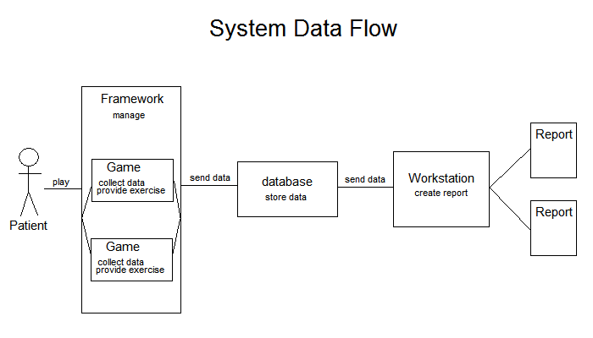
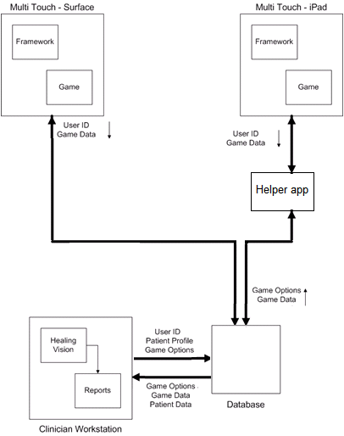
System Architecture

Slide 13
Use Cases

Slide 14
Login Screen

Slide 15
Home Screen

Slide 16
Alternate Home Screen

Slide 17
Froggie Says Intro

Slide 18
Froggie Says Game

Slide 19
Froggie Says End

Slide 20
Surface Design

Slide 21
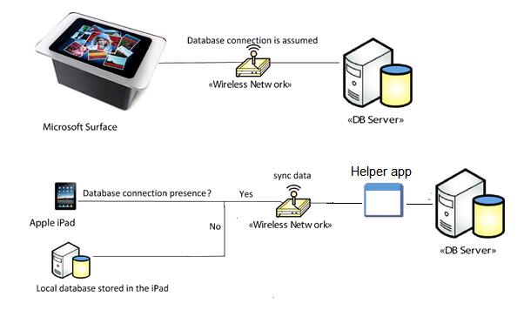
Ipad Framework
Similar to Surface framework
Intended to be a take-home device: No social play games.
Smaller screen: cannot measure ability to reach
Not always be able to connect to the database
Cannot connect directly to the database (no native support from SDK)

Slide 22
Database
Overview
Microsoft SQL 2008 R2
Data
Store patient game information
No personal information
Connectivity
Surface
iPad
Healing Vision

Slide 23
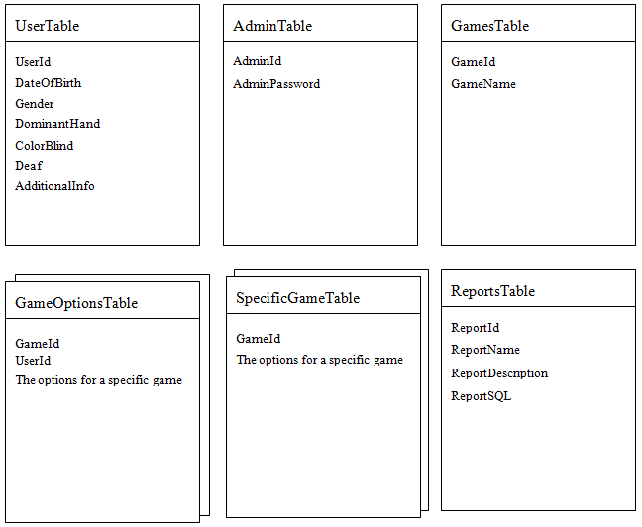
Database
Database Tables

Slide 24
Healing Vision
Has the capabilities to:
Add and edit users
Generate reports by querying the database
Save custom reports
Edit game options

Slide 25
Logging into Healing Vision

Slide 26
Adding a User

Slide 27
Editing a User

Slide 28
Editing a User

Slide 29
Editing a User

Slide 30
Generating a Report

Slide 31
Querying the Database

Slide 32
Saving a Query

Slide 33
Setting Game Options

Slide 34
Healing Vision Design

Slide 35
Next Semester Plans
Project Continuation
Iteration Progression
Documentation
User Manual
Test Plan
Developer’s Guide
Continue Document Revisions
Conferences
North Texas Area Student Conference (NTASC) – March 10
Student Research Symposium (SRS) – April 15
Industry Advisory Board Presentation – April 29

